Slide 1
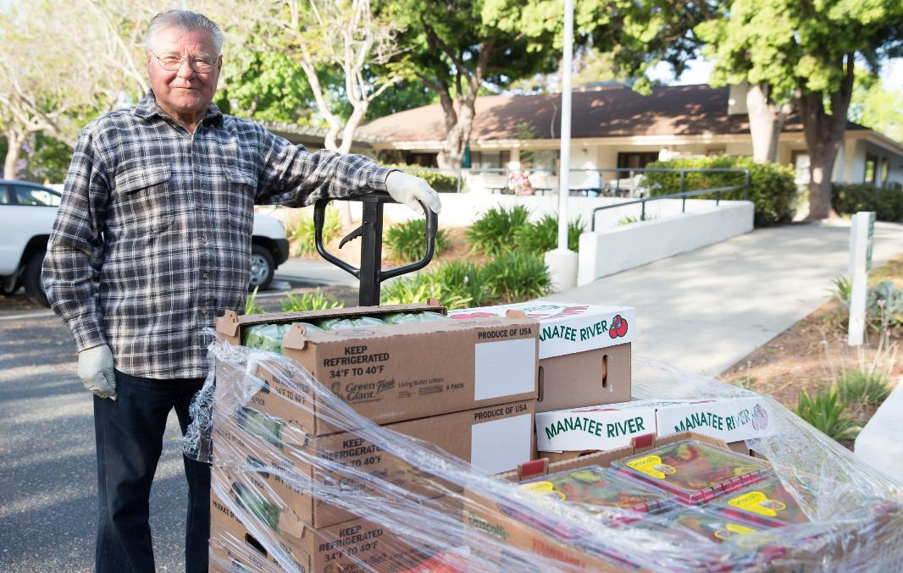

TOGETHER
WE CAN
SOLVE
SENIOR HUNGER
Collaborating to Solve Senior Hunger in America

Slide 2

Our Agenda
Senior Hunger in America
Strategic Alignment and Collaboration to Better Serve Hard-to-Reach Seniors
Joint Collaboration Models and Keys to Success
Discussion and Taking Action to Solve Senior Hunger in Your Community

Slide 3
1
Senior Hunger in America

Slide 4

5.3 MILLION
ADULTS 60+
ARE FOOD
INSECURE
4 MILLION MORE
FACE THE THREAT
OF HUNGER

Slide 5

Food insecurity among seniors is increasing while the population of seniors is rising
Notes:
Talking Points
In short, while the sheer number of seniors is doubling, the rate of food insecurity among those seniors is also exponentially increasing, leading many to project high levels of need among seniors in the future.
That’s where Feeding America and great supporters like you come in. Together we can prepare for this surge now so we can support seniors in need today and tomorrow.
Together we can work to create interventions that aim to reduce food insecurity for seniors so we can help stop hunger before it starts.
Supporting Facts:
10,000 baby boomers will turn 65 every day for the next 14 years.
Simultaneously, the rate of food insecurity among seniors is projected to double by 2025, when compared to 2001.

Slide 6

Food-Insecure Seniors Face Serious Health Challenges
Compared to their food-secure
peers, food-insecure seniors are:
60%
More likely to experience depression
53%
More likely to report a heart attack
52%
More likely to develop asthma
40%
More likely to report an experience of congestive heart failure
Consistent access to nutritious foods improves the effectiveness of medications and helps seniors stay healthy and strong.
Source: Spotlight on Senior Health
Notes:
Talking points:
Because food-insecure seniors are not always able to obtain the nutrient-rich food they need to enable their medications to work effectively and help keep themselves healthy, they face significant health changes.
Over the past five years, Feeding America has intensified its research on domestic senior hunger. Today, we have a better understanding than ever before about seniors’ vulnerability to the negative health implications of food insecurity.
Thanks to this work, we have a better understanding of how and why our role in serving low-income seniors is an incredible responsibility that we take very seriously.
Additional info:
Recent research includes Spotlight on Senior Hunger and Spotlight on Senior Health: Adverse Health Outcomes of Food Insecure Older Americans, both released in partnership with the National Foundation to End Senior Hunger (NFESH). Our most recent study, Baby Boomers and Beyond: Facing Hunger after Fifty, was published July 2015 in partnership with the AARP Foundation and the University of Illinois. We intend to use this original and critical information to boost our advocacy efforts in support of the Older Americans Act, critical legislation that has helped low-income seniors for 50 years.

Slide 7
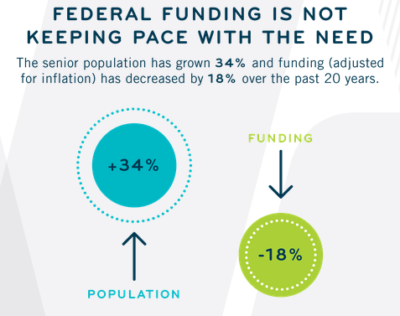
Source: Meals on Wheels America
Notes:
However federal funding is not keeping pace with the need. The charitable sector is expanding to fill the gap, but the population of the country continues to age.

Slide 8
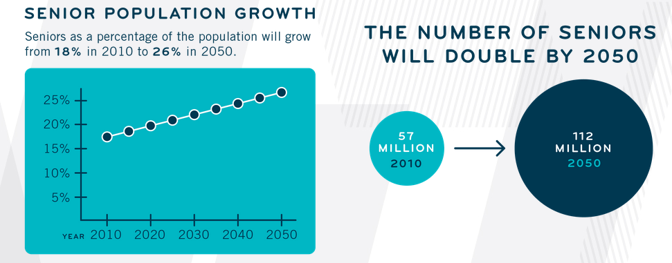
Source: Meals on Wheels America
Notes:
In fact, by 2050, 26% of our country is projected to be over age 60.

Slide 9
Serving Seniors
Seniors have a continuum of need based on their health, mobility and transportation status:
Not Homebound, Can Cook or Access Meals
Homebound
Can Cook
Homebound Cannot Cook
Different interventions are required in order to meet the needs of seniors throughout the continuum.
Notes:
Older Americans have a continuum of need based on their mobility and ability to prepare meals. Different interventions are required to reach seniors throughout this continuum of need.
The Feeding America senior strategy divides this continuum of need into three broad categories: 1) seniors who are not homebound and can cook or access meals, 2) seniors who are homebound and can cook, 3) seniors who are homebound and can’t cook.

Slide 10
Serving Food-Insecure Seniors
Homebound,
Can Cook:
Lead Role for Meals on Wheels America – Home-Delivered Programs
Supporting Role for Feeding America
Not Homebound:
Lead Role for Feeding America
Lead Role for Meals on Wheels America – Congregate Dining Programs
Homebound, Cannot Cook:
Lead Role for Meals on Wheels America – Home-Delivered Programs
Supporting Role for Feeding America
Source: Special Analysis of NHANES Data from Craig Gundersen | December 2015
Notes:
Feeding America invests the lion’s share of activities targeted for seniors on increasing access to food for seniors who are not homebound. We primarily focus our strategy on this segment because of the alignment of serving this population with the core competencies of our nationwide network of 60,000 food pantries and meal programs.
To meet the needs of other seniors among the spectrum, Feeding America and the network additionally invest in serving homebound seniors, often conducted very effectively and efficiently through various partnership models.

Slide 11
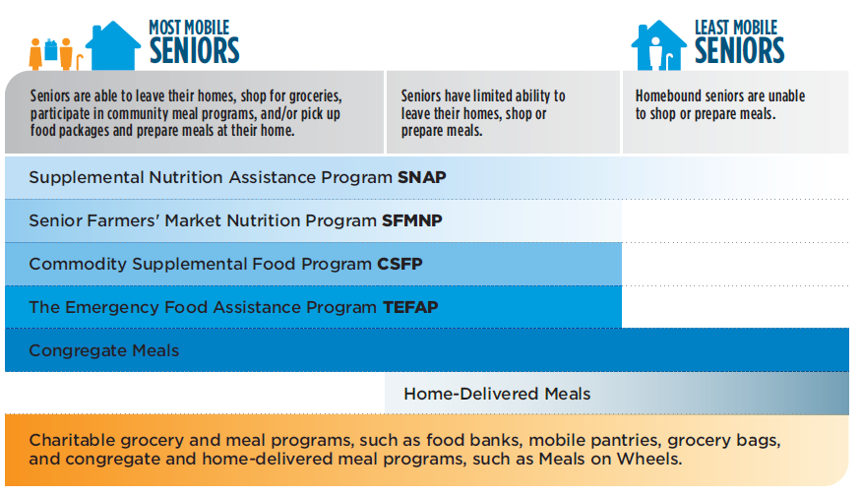
Federal Nutrition Programs Serving At-Risk Seniors
Notes:
There are highly effective and supportive Federal and nonprofit programs designed to support seniors with unique needs.

Slide 12
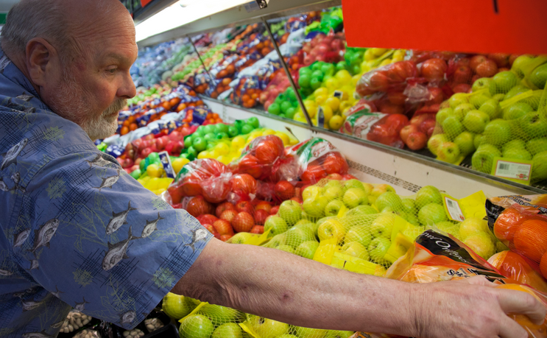
Just 42% of eligible older Americans are enrolled in SNAP, compared to 83% of all eligible individuals.
Together we can close the senior SNAP gap.

Slide 13
2
Strategic Alignment and Collaboration to Better Serve Hard-to-Reach Seniors

Slide 14








VISION
A hunger-free America
MISSION
To feed America's hungry through a nationwide network
of member food banks and engage our country in the fight to end hunger.
Notes:
At Feeding America our vision is a hunger-free America and our mission is to end hunger

Slide 15

The Feeding America Network
200
46M
MEMBER
FOOD BANKS
1
AMERICANS
SERVED ANNUALLY
NATIONAL
OFFICE
60K
FOOD PANTRIES
AND MEAL PROGRAMS
Notes:
Talking points:
Feeding America is a nationwide network of 200 local food banks, 60,000 feeding programs and 1 national office. Together we provide meals to more than 46 million people each year, including 12 million children and 7 million seniors
We feed people in all 50 states, Washington, D.C. and Puerto Rico

Slide 16
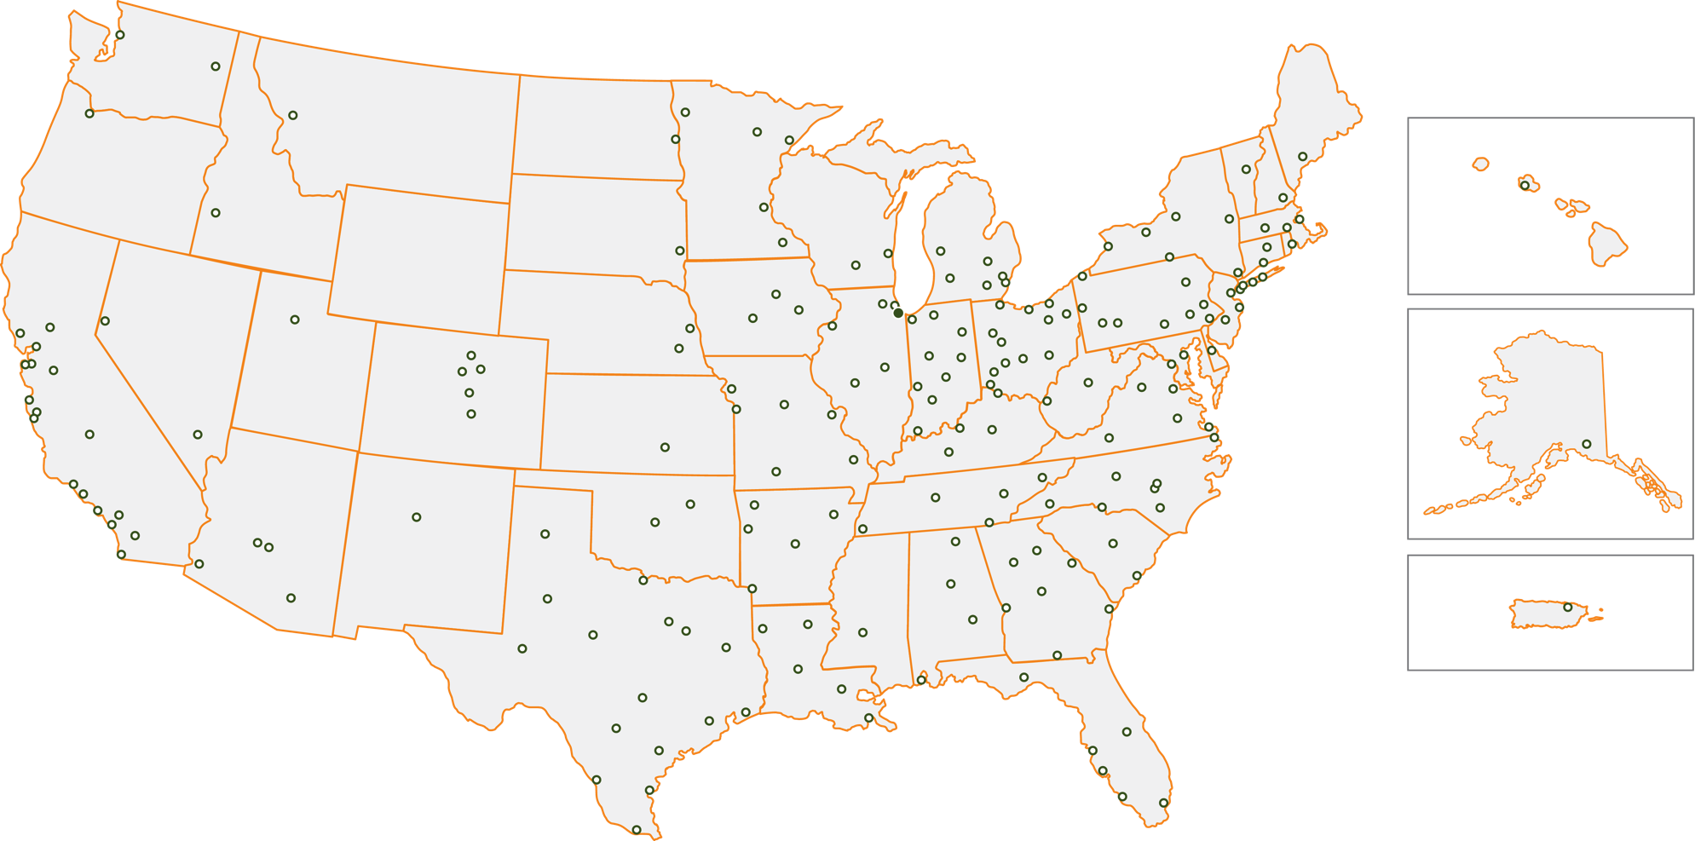
The Feeding America Network Serves Virtually Every Community
Notes:
Dots indicate food bank locations.
Talking Points:
The extensive Feeding America network feeds more than 46 million people in all 50 states, Washington, D.C. and Puerto Rico
Network food banks are on the ground, everyday in nearly every community in the country feeding people in need
The unique and dynamic partnership between the national office and each local food bank is the power of Feeding America.
FA serves nearly every community in the US, even in those states without a FA food bank. We can do this because our food banks transport and distribute food to food pantries and meal programs throughout their region. Also, mobile pantries allow us to bring food to areas that are not serviced by food pantries and meal programs. Because the national office oversees our network of food banks, we can ensure that this happens efficiently and that food banks have the greatest impact throughout the area.
Additional info:
We have 19 partner state associations. A State Association is an informal or formal group of food banks and/or food rescue organizations within a state which form for the purpose of promoting their cause as a group. State associations partner with food banks through: produce sourcing, disaster relief and preparedness, advocacy and policy, partnerships and thought leadership.
We have partner state associations in the following states: Alabama, Arizona, California, Florida, Georgia, Illinois, Indiana, Iowa, Kentucky, Louisiana, Michigan, Missouri, North Carolina, Ohio, Pennsylvania, Texas, Virginia, Washington and Wisconsin.
We are a much larger system compared to non-Feeding America food banks. Feeding America has 200 food banks.
To be a member of the FA network, food banks must adhere to the highest standards of the nonprofit industry for food safety, fundraising, governance and other key areas. All food banks and FA national office sign a mutually binding contract that both are governed by.
Sometimes food banks may opt not to be in the Feeding America network if they do not feel they can comply with our high standards and stringent food safety requirements.

Slide 17


How We Work
We Secure Donations
The Feeding America network secures donations from national and local retailers, food companies and government agencies.
We Move Food
The Feeding America network of food banks moves donated food and grocery products to where they are needed most.
We Safely Store and Distribute Donations
Member food banks ensure the safe storage
and reliable distribution of donated goods to local charitable feeding programs.
We Feed People in Need
Food banks provide food and grocery items to people in need at food pantries, soup kitchens, youth programs, senior centers and emergency shelters.
Notes:
Talking points:
The process of getting food to Americans in need requires a dynamic infrastructure and sophisticated management.
Feeding America secures donations from national food and grocery manufacturers, retailers, shippers, packers and growers and from government agencies, individuals and other organizations.
Then Feeding America moves donated food and grocery products to member food banks, which ensure the safe storage and reliable distribution of goods to local food pantries and meal programs.
The food banks in turn distribute food and grocery items to people in need through food pantries and meal programs that serve children, families, seniors and other groups at risk of hunger.
The Feeding America network goal is to source 6 billion meals to people in need annually by 2025

Slide 18






The Impact of the Feeding America Network
We serve
46 MILLION AMERICANS
annually, including 12 million children and 7 million seniors
We source and distribute
11 MEALS
for each $1 donated
We provide
3.7 BILLION MEALS
each year to people in need
We source
1.1 BILLION POUNDS
of fruits and vegetables
through the network
We conduct SNAP application assistance to enable access to
185 MILLION MEALS
2 MILLION VOLUNTEERS
help carry out our vision for a hunger-free America
Source: Feeding America Network Activity Report and Hunger in America 2014
Notes:
Additional Info:
Technically, Feeding America serves 46.5M Americans.
According to Hunger in America 2014, in an average month, nearly two million volunteers across the Feeding America network provide more than 8.4 million hours of assistance to partner agencies at food programs.
Feeding America is still serving the same number of households – however the number of children per household has decreased. This is partly due to a decline in birth rate during the recession. Overall, we believe we are vastly under representing the number of children we serve because we cannot ethically interview/survey children – making it hard for us to get a full understanding of this population and Feeding America's service to them.

Slide 19
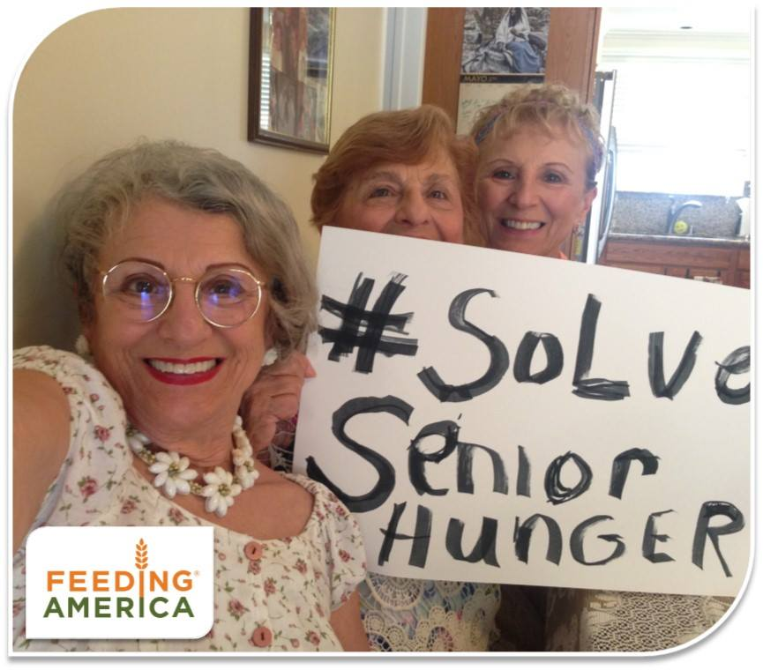


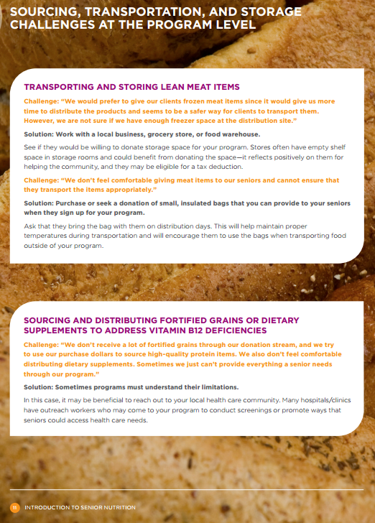
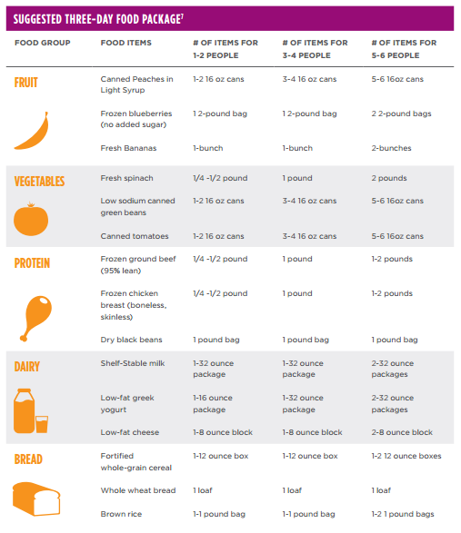
Feeding America: Senior Hunger Strategy
Build Awareness
Appropriate Interventions
Increase Access
#SolveSeniorHunger Older Americans Month awareness campaign
Research and communications resources
Build capacity for Senior Grocery
Program and
other effective programs
Advocacy for federal programs: CSFP expansion, targeted SNAP outreach, TEFAP
Promote and source senior-appropriate food items
Nutrition education resources to support food banks
Provide access to enough nutritious food for all seniors struggling with hunger and improve food security to help seniors stabilize their lives.
Notes:
The Feeding America network provides 49 million meals a year to older adults through the Senior Grocery Program. The program distributes healthy foods that address the unique dietary needs of seniors in locations where they live or regularly frequent.

Slide 20
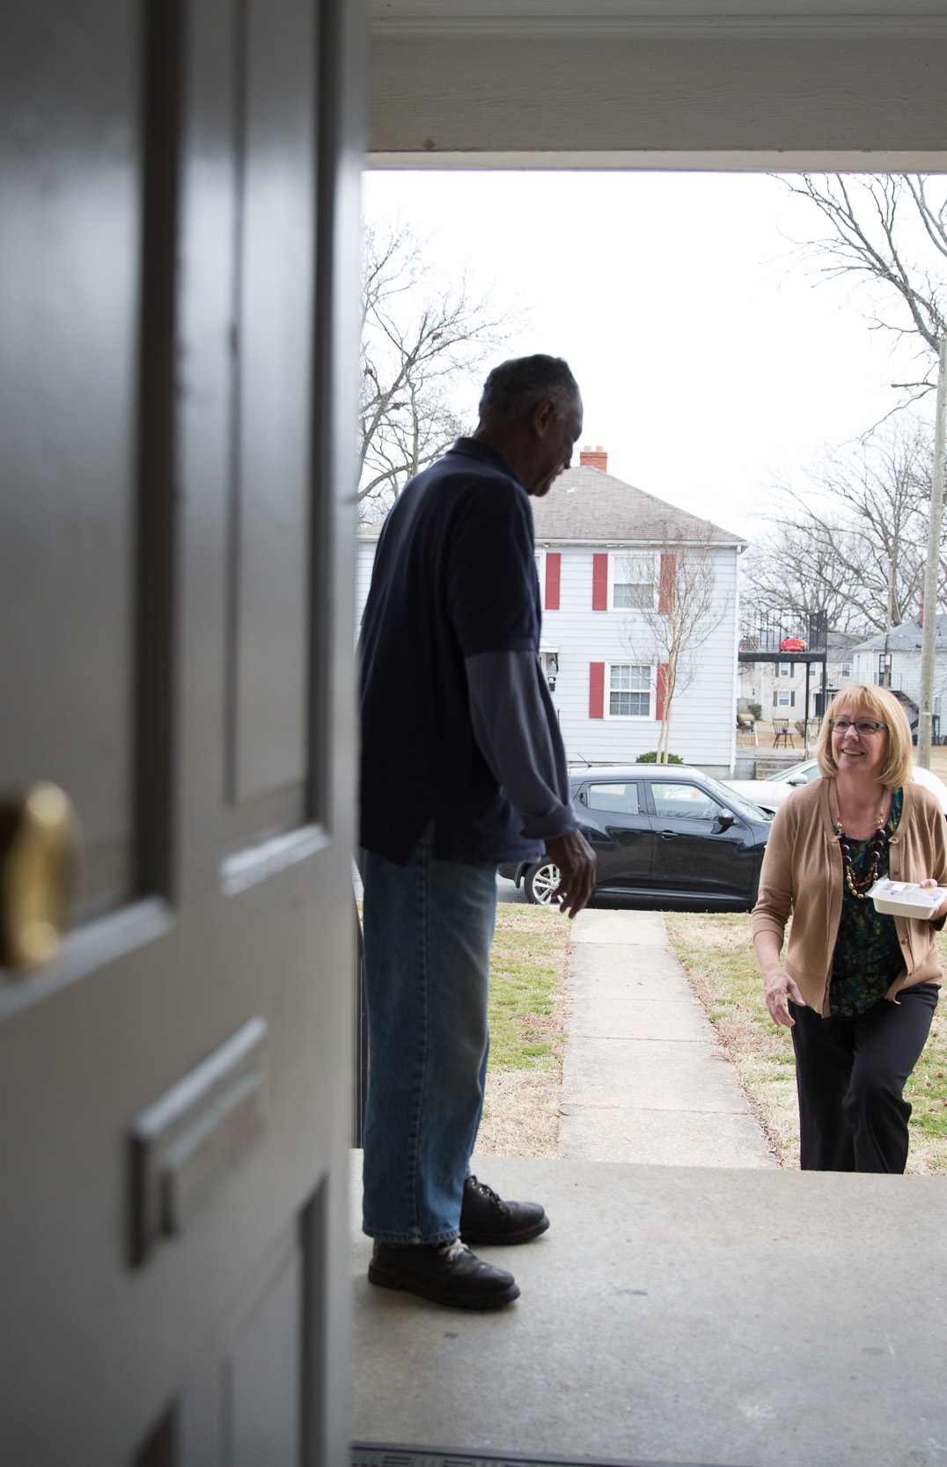

Meals on Wheels America
Our Vision
An America in which all seniors live nourished lives with independence and dignity.
Our Mission
To empower local community programs to improve the health and quality of life of the seniors they serve so that no one is left hungry or isolated.

Slide 21


Who We Represent
Nationwide network of 5,000+
In virtually every community in America
Deliver 1 million meals with companionship every day
Serve over 2.5 million seniors
Leverage 2 million dedicated volunteers to make it happen
Taking a stand and lifting a hand for their senior neighbors
Notes:
One of the great social movements in America = communities stepping up to support their senior neighbors

Slide 22

How We Work – Empowering Our Members
RESEARCH
FUNDING
EDUCATION
ADVOCACY SUPPORT
LEADERSHIP
TRAINING

Slide 23



Collectively Meals on Wheels programs fight three of the biggest threats from aging:
HUNGER ISOLATION SAFETY

Slide 24
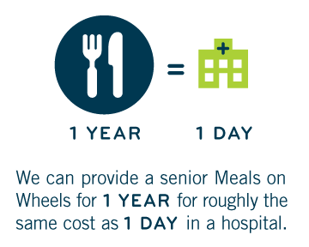
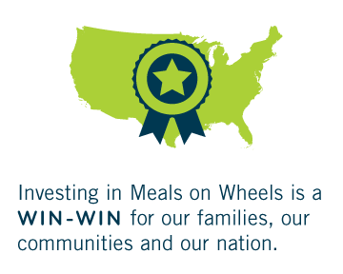
Meals On Wheels Is An Effective And Proven
Public-private Partnership
Source: Meals on Wheels America

Slide 25
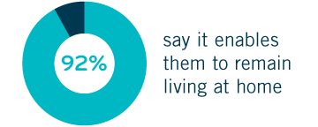


Meals on Wheels Programs Deliver Impactful Programs
Keeping Seniors in Their Own Homes
Source: Meals on Wheels America

Slide 26
Serving Seniors
Seniors have a continuum of need based on their health, mobility and transportation status:
Not Homebound, Can Cook or Access Meals
Homebound
Can Cook
Homebound Cannot Cook
Different interventions are required in order to meet the needs of seniors throughout the continuum.
Notes:
Older Americans have a continuum of need based on their mobility and ability to prepare meals. Different interventions are required to reach seniors throughout this continuum of need.
The Feeding America senior strategy divides this continuum of need into three broad categories: 1) seniors who are not homebound and can cook or access meals, 2) seniors who are homebound and can cook, 3) seniors who are homebound and can’t cook.

Slide 27
Feeding America – Meals on Wheels America Collaboration Goal
To strengthen the relationship between Feeding America and Meals On Wheels America, and collaborate to increase access to food assistance for older adults – raising awareness about the serious problem of senior hunger, both at the national level and through collaborations between our networks at the local level.
Through this effort, we hope to create a productive synergy, leveraging shared innovations and assets to raise awareness about senior hunger and identify tangible solutions to address senior hunger in America.

Slide 28
3
Joint Collaboration Models and Keys to Success

Slide 29








Six Collaboration Models
MEAL PARTNERS
SUPPLEMENTAL FOOD PARTNERS
FOOD PURCHASE PARTNERS
COMMUNITY COALITION PARTNERS
OUTREACH AND BENEFITS ASSISTANCE PARTNERS
ADVOCACY PARTNERS
Notes:
Talking points:
Feeding America regularly engages universities and other researchers to evaluate our programs.
This helps us better understand our impact on food-insecure families and communities, as well as enabling us to uncover and tackle additional challenges.
These evaluations were recently completed, however we will continue to evaluate these programs in the future as well as other Feeding America programs and initiatives.
Additional info:
BackPack Program Evaluation: Evaluates selection process for participants and the effect of the program on children’s school attendance. Study found that the program enrolls the highest needs children; results in slight increase in attendance when BackPacks are distributed; and helps the entire family.
BP Program Nutrition and Sustainability Evaluation: Evaluates nutritional quality of food provided through the BackPack Program. Study found overall nutritional quality was high but high cost of food was barrier to program. Average BackPack cost in network is $3.86.
School Pantry Program Evaluation: Evaluates operations of pantry programs, client satisfaction and how well school pantry programs are meeting needs. Study found program relieved clients worry about having enough food however, awareness of program was low. Also various program delivery mechanisms (e.g. mobile vs. brick and mortar) exist and can meet clients needs.
Child Hunger Corps Evaluation: Examined the first several years of the pilot. Host food banks have a greater increase in average # of meals served to children. Corps members heightened FB visibility in local community. Impact beyond meals (e.g. SNAP, grant writing).
Kids Café Evaluation: Evaluates key drivers behind program successes and challenges. Study found that keys to success included dedicated staff and a stable site.
SNAP Outreach Case Studies: In FY 2014 Feeding America initiated a multi-site program evaluation case study that examined geographic context, multi-year program trends, diversity in program models, resources, leadership, and priorities of food banks. Nine network member food banks across six different states participated in the case study.
Results of the SNAP Outreach Case Study: In total, during the case study, eight food banks collectively pre-screened 48,840 people for SNAP benefits in eight months; of these, 57 percent of clients were deemed ineligible or were unable to produce required documentation. Of the remaining 20,954 people who were pre-screened and deemed eligible, 55 percent (11,564 people) submitted a SNAP application to their governmental SNAP agency with food bank support; 45 percent, or more than 9,000 eligible individuals did not submit an application with the assistance of the food bank, although it is possible that some completed applications on their own.

Slide 30



Meal Partners
Definition:
Meals on Wheels agency receives donated food from the local food bank to create meals for their recipients.
Example:
In Vermont, Meals on Wheels of Bennington Country receives about 70% of it’s food annually from the Food Bank of Vermont.

Slide 31



Supplemental Food Partners
Definition:
Food bank provides boxes or bags of food to be delivered as a supplement to Meals on Wheels meals.
Example:
Northern Illinois Food Bank’s Senior Box Program provides nutritious easy-to-prepare foods to seniors via Lifescape Community Services - persons who are capable of cooking, but lack access to food due to financial or physical challenges.

Slide 32

Food Purchase Partners
Definition:
Food bank purchases food at low cost; Meals on Wheels partner purchases or receives that food for programing.
Note:
The largest area of caution for food banks and Meals on Wheels senior nutrition programs is regarding handling of donated product and ensuring that IRS Code 170(e)(3) is upheld.
The IRS Code 170(e)(3) only applies to donated product, so food banks can provide Meals on Wheels programs with purchased food to utilize in preparing meals.

Slide 33



Community Coalition Partners
Definition:
Meals on Wheels and local food banks partner to make an impact for people in their community.
Example:
Metropolitan Interfaith Association (MIFA) and Mid-South Food Bank in Memphis, Tennessee, are collaborating with area hospitals to quantify the impact of nutrition on senior health. In a pilot project they delivered healthy meals and food boxes to the homes of seniors after hospital stays.

Slide 34
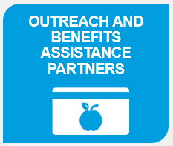
Outreach and Benefits Assistance Partners
Definition:
Meals on Wheels and local food banks partner to increase access to benefits for eligible clients.
Examples:
Two-thirds of Feeding America food banks offer SNAP Application Assistance, often in the form of direct volunteer assistance, a hotline or other localized outreach or assistance materials. These materials can be inserted into meal deliveries or volunteers could accompany delivery for an interested and eligible senior.

Slide 35

Advocacy Partners
Definition:
Meals on Wheels America, Feeding America and local affiliates partner to elevate the voices of the people we serve and advocate for policy solutions that strengthen federal nutrition assistance programs.
Examples:
Older Americans Act
  Reauthorization for congregate and home-delivered meals
Supplemental Nutrition Assistance Program (SNAP)
  Outreach and strengthened access such as simplified applications
Commodity Supplemental Food Program (CSFP)
  Provide funding to expand program nationwide

Slide 36
Common Success Factors
Goal alignment and complimenting strengths
Flexibility and willingness
Strong leadership and positive relationships – leaders are committed and engaged in the partnership
Constant and intentional communication
Multiple touch points – food bank and agency partnering in multiple or robust ways
Spend time together on various coalitions and community initiatives
Notes:
Key Takeaways from Vermont
Partnership success factors
Goal alignment
The food bank has made an organizational commitment to distribute more produce and nutritious food. The Meals on Wheels agency wants to provide more produce and nutritious food.
The agency is located in the southern part of the state, the food bank wants to increase meals provided to people in need in that part of the state.
Flexibility and willingness
Meals on Wheels agency is really good at taking almost any and all product the food bank has to offer – finding ways to innovate and plug foods into ghost recipes to make unique, nutritious and tasty meals.
Meals on Wheels agency has a balanced staff, one individual has a background as a high end chef and one has a background creating a mass quantity of meals, together
Constant communication
Staff from both parties participate in and interact at the same community meetings
Food bank delivers food twice a month and director of the Meals on Wheels agency is communicating more regularly, sharing what they want with distribution staff and inviting food bank drivers into their kitchen to see how the food they have provided is being used, additionally giving the driver ideas to share at their next “port of call”

Slide 37
Common Challenges
Storage space may be an issue for some Meals on Wheels programs, limiting their ability to accept all the produce and fresh food from the food bank and other local partners
The food bank doesn’t offer packaged food but ingredients – the agency needs to know how to cook and be creative with ingredients
Limited dedicated staff – volunteers could be leveraged but training is intensive and space is limited at agencies
Funding is the lynch pin that could take agency operations to the next level

Slide 38
Universal Partnership Tips
Create a shared vision – spend time planning
Take it slow – try a pilot
Identify and address each partners needs and expectations
Identify and utilize the strengths of each partner
Handle disagreements, disappointments and frustrations early
Get the right people in the right seat
Support the partnership's limitations
Facilitate continuous and transparent communication

Slide 39
4
Discussion and Taking Action to Solve Senior Hunger in Your Community

Slide 40
Discussion – Solving Senior Hunger in Your Community
What organizations in your community have you found synergies with and opportunities for partnership?
What is the number one reason the partnership is successful?
What is the biggest challenge in the partnership?
What about your organization enables the partnership to be successful?
What support do you leverage or would you leverage to make the program more successful or sustainable?
In what ways would you evaluate the success of the partnership?

Slide 41
Take Action – Get Introduced!
The first step is getting to know your local providers.
Find contact information for the Feeding America food bank(s) in your community by typing in your zip code or searching by city and state at feedingamerica.org/foodbank
Find contact information for the Meals on Wheels America member(s) in your community by typing in your zip code or searching by city and state: mealsonwheelsamerica.org/signup/aboutmealsonwheels/find-programs

Slide 42
5
What’s Next?

Slide 43
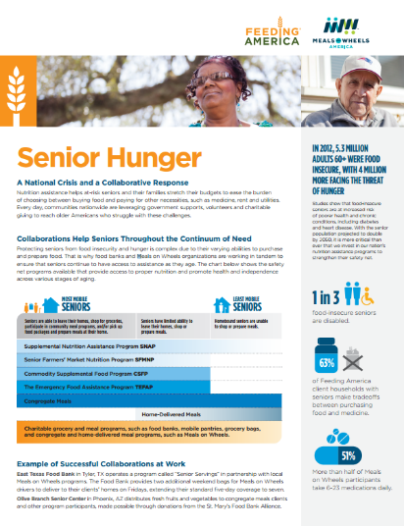
Sharing our Work
Feeding America and Meals on Wheels America Collaborate to Solve Senior Hunger

Slide 44

Local Partnership Toolkit – Coming Soon
Links and Resources
Internal Case Study Summary
FAQ and Partnership Guide

Slide 45

JOINT POLICY SOLUTIONS TO STRENGTHEN FEDERAL NUTRITION ASSISTANCE PROGRAMS
Older Americans Act
  Reauthorization for congregate and home-delivered meals
Supplemental Nutrition Assistance Program (SNAP)
  Outreach and strengthened access such as simplified applications
Commodity Supplemental Food Program (CSFP)
  Provide funding to expand program nationwide

Slide 46
TAKE ACTION! #SolveSeniorHunger
May is Older Americans Month
Engage local media
  Coordinate with fellow providers to tell the story of the public-private partnership to solve senior hunger
Engage elected officials
  Educate your members of Congress, your governor by inviting them to visit your site.
For more information:
Meals on Wheels America’s Resources: http://www.mealsonwheelsamerica.org/take-action/advocate
Feeding America’s Resources
www.feedingamerica.org/solveseniorhunger
Got Questions? Contact:
Erika Kelly, Erika@mealsonwheelsamerica.org
Eleni Towns, etowns@feedingamerica.org

Slide 47
House Education & Workforce
Congressional Targets
John Kline (R-MN) | Bobby Scott (D-VA-03)
Joe Wilson (R-SC-02) | Ruben E. Hinojosa (D-TX-15)
Virginia A. Foxx (R-NC-05) | Susan A. Davis (D-CA-53)
Duncan D. Hunter (R-CA-50) | Raul M. Grijalva (D-AZ-03)
Phil Roe (R-TN-01) | Joe Courtney (D-CT-02)
Glenn W. Thompson (R-PA-05) | Marcia L. Fudge (D-OH-11)
Tim L. Walberg (R-MI-07) | Jared Polis (D-CO-02)
Matt Salmon (R-AZ-05) | Gregorio K. Sablan (D-MP)
Brett Guthrie (R-KY-02) | Frederica S. Wilson (D-FL-24)
Todd E. Rokita (R-IN-04) | Suzanne M. Bonamici (D-OR-01)
Lou J. Barletta (R-PA-11) | Mark Pocan (D-WI-02)
Joe J. Heck (R-NV-03) | Mark A. Takano (D-CA-41)
Luke Messer (R-IN-06) | Hakeem Jeffries (D-NY-8)
Bradley R. Byrne (R-AL-01) | Katherine M. Clark (D-MA-5)
David Brat (R-VA-07) | Alma Adams (D-NC-12)
Buddy Carter (R-GA-01) | Mark DeSaulnier (D-CA-11)
Michael Bishop (R-Mi-08)
Glenn Grothman (R-WI-06)
Steve Russell (R-OK-06)
Carlos Curbelo (R-FL-26)
Elise Stefanik (R-NY-21)
Rick Allen (R-GA-12)
Senate HELP Committee
Lamar Alexander (R-TN) | Patty Murray (D-WA)
Mike Enzi (R-WY) | Barbara Mikulski (D-MD)
Richard Burr (R-NC) | Bernie Sanders (D-VT)
Johnny Isakson (R-GA) | Al Franken (D-MN)
Rand Paul (R-KY) | Michael Bennet (D-CO)
Susan Collins (R-ME) | Sheldon Whitehouse (D-RI)
Lisa Murkowski (R-AK) | Chris Murphy (D-CT)
Mark Kirk (R-IL) | Elizabeth Warren (D-MA)
Tim Scott (R-SC)
Orrin Hatch (R-UT)
Pat Roberts (R-KS)
Bill Cassidy (R-LA)

Slide 48

THANK YOU!
Uche Akobundu
Meals on Wheels America Director of Project Management and Impact
uche@mealsonwheelsamerica.org
571.339.1629
Emily Basten
Feeding America Senior Manager of Program Development
ebasten@feedingamerica.org
312.641.5379

